Slide 1
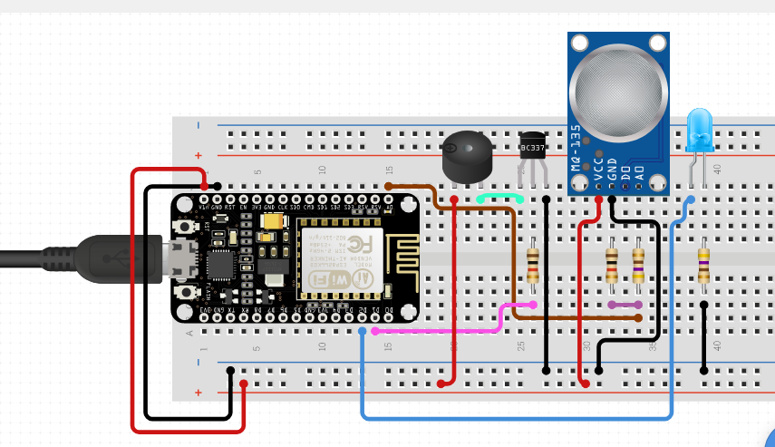
Air Quality + MQ-135 + NodeMCU-ESP8266 + Blynk

